Slide 1

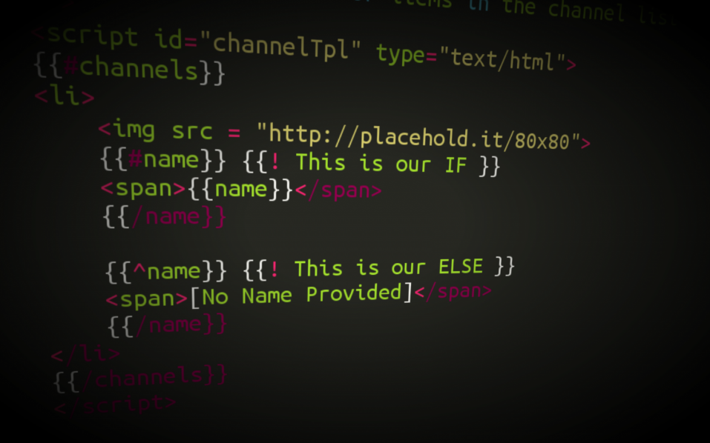



Underscore.JS
Extending the Functionality
of Collections
SoftUni Team
Technical Trainers
Software University
http://softuni.bg

Slide 2


Table of Contents
What is Underscore.js?
What extensions does it offer?
Collection extensions
Array extensions
Function extensions
Object extensions

Slide 3
Underscore.js
Underscore.js is a JavaScript library, that extends regular JavaScript functionality
Provides extensions to object, arrays, selection, etc..
Usable is client JavaScript (web and mobile) and server JavaScript (Node.js)

Slide 4
Underscore.js Functionality
Underscore extends the functionality for:
Collections
each, map, find, filter, where, some, countBy
Arrays
first, last, union, uniq, range
Functions
bind, delay, defer, once, after
Objects
keys, values, extend, functions, clone
Templates and Chaining

Slide 5
Extensions for Collections

Slide 6
Collections
Collections == arrays and objects
All underscore methods work both on arrays and objects (associative arrays)
Collection extensions:
_.each() - iterates over a collection
_.map(), _.pluck() - a projection of a collection
_.filter(), _.reject() and _.where - filter elements
_.all() and _.any() - evaluate a collection
_.sortBy(), _.groupBy() - sorts and groups

Slide 7
Collections: each()
_.each() iterates over a list of elements, yielding each in turn to an iterator function
Similar to for-in loop
Uses the native forEach() function if the browser supports it
var numbers = [1, 2, 3, 4, 5, 6, 7, 8];
_.each(numbers, console.log);
_.each(numbers, function(item) { console.log(item); }
//log all the numbers

Slide 8
_.each()
Live Demo

Slide 9
Collections: map()
_.map() produces a new array of elements, after the values are computed
Uses the native map() function if the browser supports it
Can be used with objects as well:
var numbers = [0, 1, 2, 3, 4, 5, 6, 7, 8];
var numberNames = ["zero", "one", "two", "three"];
function numbersToNames(item) { return numberNames[item]; }
_.map(numbers, numbersToNames);
_.map(console, function (item) {
return item.toString();
});

Slide 10
_.map()
Live Demo

Slide 11
Collections: filter() and reject()
Filter and reject return a subset of the original collection, based on an boolean expression
Filter returns all items matching the condition
Reject returns all items that do not fulfill the condition
var numbers = [0, 1, 2, 3, 4, 5, 6, 7, 8];
var even = _.filter(numbers, isEven);
var odd = _.reject(numbers, isEven);
function isEven(number) {
return number % 2 === 0;
}

Slide 12
_.filter() and _.reject()
Live Demo

Slide 13
Collections: where()
_.where() filters a collection based on a property value
Returns a subcollection of the original collection
var people = [{name: "Ivan Todorov", age: 21},
{name: "Todor Ivanov", age: 11},
{name: "Petra Georgieva", age: 14},
{name: "Georgi Petrov", age: 11},
{name: "Stamina Staminova", age: 19}];
var elevenYearsOld = _.where(people, {age: 11});
// returns Todor Ivanov and Georgi Petrov

Slide 14
_.where()
Live Demo

Slide 15
Collections: all() and any()
_.all() returns true if ALL of the elements that meet a boolean expression
_.any() returns true if ANY of the elements fulfill a boolean condition
And false if none if the elements fulfill the condition
var numbers = [1, 2, 3, 4, 5, 6, 7, 8, 9, 10];
var anyEven = _.any(numbers, function(el){ return el % 2 == 0; });
//anyEven = true
var allEven = _.all(numbers, function(el){ return el % 2 == 0; });
//allEven = false;

Slide 16
_.all() and _.any()
Live Demo

Slide 17
Collections: pluck()
_.pluck() returns a projection of a collection
Returns only a part from all elements
A simplified version of _.map()
var people = [
{username: "VGeorgiev", email: "vlado@softuni.bg"},
{username : "Teodor92", email: "kurtev@softuni.bg"},
{username : "nakov", email: "spam@nakov.com"},
{username : "Petya", email: "petya@softuni.bg"}];
var emails = _.pluck(people, 'email');
// emails = ["vlado@softuni.bg", "kurtev@softuni.bg", "spam@nakov.com", "petya@softuni.bg"]

Slide 18
_.pluck()
Live Demo

Slide 19
Collections: sortBy()
_.sortBy() sorts the elements of a collection
Much like the native sort() function
Sorts by a property or an iterator function
var students = [
{fname: "Mitko", lname: "Ruletkata", age: 63},
{fname: "Gencho", lname: "Ganev", age: 32},
{fname: "Penio", lname: "Penev", age: 10},
{fname: "Unufri", lname: "Unufriev", age: 17}];
var sortedByLastname = _.sortBy(students, "lname");
var sortedByAge = _.sortBy(students, "age");

Slide 20
Collections: groupBy()
_.groupBy() groups the elements of a collection
Groups by a property or an iterator function
var cars = [
{make: "Nissan", model: "Skyline", color: "red"},
{make: "Audi", model: "A6", color: "blue"},
{make: "Lada", model: "Vesta", color: "red"},
{make: "Moskvich", model: "412", color: "yellow"},
{make: "Peugeot", model: "206", color: "red"}];
var carsByColor = _.groupBy(cars, "color");

Slide 21
_.sortBy() and _.groupBy()
Live Demo

Slide 22
Array Extensions

Slide 23
Array Extensions
Array extensions work only on array objects
Does not work on associative arrays or objects
Array extensions:
_.first() and _.initial() selects the first n items
_.last() and _.rest() selects the last n items
_.compact() - removes all false values
_.union() and _.intersect() - unites or intersects two or more arrays

Slide 24
Arrays: first() and initial()
_.first() returns the first element in an array
Can be used with a parameter to return the first n elements
_.initial() returns all elements except the last one
Can be used with a parameter to all the elements except the last n
var numbers = [1, 2, 3, 4, 5];
var first = _.first(numbers); // 1
var firstTwo = _.first(numbers, 2); // [1, 2]
var numbers = [1, 2, 3, 4, 5];
var initial = _.initial(numbers); // [1, 2, 3, 4]
var initialTwo = _.initial(numbers, 2); // [1, 2, 3]

Slide 25
_.first() and _.initial()
Live Demo

Slide 26
Arrays: last() and rest()
_.last() returns the last element in an array
Can be used with a parameter to return the last n elements
_.rest() returns all elements except the first one
Can be used with a parameter to return everything after the first n
var numbers = [1, 2, 3, 4, 5];
var first = _.last(numbers); // 5
var firstTwo = _.last(numbers, 2); // [4, 5]
var numbers = [1, 2, 3, 4, 5];
var initial = _.rest(numbers); // [2, 3, 4, 5]
var initialTwo = _.rest(numbers, 2); // [3, 4, 5]

Slide 27
_.last() and _.rest()
Live Demo

Slide 28
Function Extensions

Slide 29
Function Extensions
Function extensions provide some additional functionality to regular functions
_.memorize(func)
Memorizes the invocation of a function
If the function is called again with the same parameters, the memorized result is returned
_.compose(func1, func2, func3)
Returns a composition list of functions
The same as func1(func2(func3()))

Slide 30
Function Extensions
Live Demo

Slide 31
Object Extensions

Slide 32
Object Extensions
Object extensions provide some additional functionality to regular objects
_.keys(obj) – list of all the keys of an object
_.values(obj) – list of the values of an object
_.invert(obj) – inverts the keys and the values
_.extend(obj, properties) – performs prototypal inheritance

Slide 33
Object Extensions
Live Demo

Slide 34







Underscore.js
https://softuni.bg/courses/javascript-applications/

Slide 35
License
This course (slides, examples, demos, videos, homework, etc.) is licensed under the "Creative Commons Attribution-NonCommercial-ShareAlike 4.0 International" license
Attribution: this work may contain portions from
"JavaScript Applications" course by Telerik Academy under CC-BY-NC-SA license

Slide 36




Free Trainings @ Software University
Software University Foundation – softuni.org
Software University – High-Quality Education, Profession and Job for Software Developers
softuni.bg
Software University @ Facebook
facebook.com/SoftwareUniversity
Software University @ YouTube
youtube.com/SoftwareUniversity
Software University Forums – forum.softuni.bg

